Slide 1
Making this resource work for you
Prior to teaching this lesson, please refer to the ‘Unit Overview and Planning Document’.
Further guidance on planning Science Mastery lessons can be found in the detailed planning guidance document.
Refer to the ‘notes’ section on each slide for useful information, including suggested expositions, pedagogical content knowledge, suggested questions, answers and more. Consider using presenter mode so you can see this guidance throughout the lesson.
The introduction slides can be adapted to suit your teaching style and the needs of your class.
Before the lesson, adapt the fix-it slide to address any misconceptions identified in the previous lesson’s exit ticket.
Choose from the suggested activities to suit your class. The intention is not that you complete all of these, but that you select those which ones are most appropriate for your students. It may be appropriate to further adapt activities for your students.
These lessons are designed to occupy approximately 1 hour. To adapt for a shorter or longer lesson duration we advise you to adapt the activity section accordingly.
Please consider using the final slide to send feedback about this lesson or examples of PowerPoints that you have adapted to our design team. Your feedback is used to improve Science Mastery for all of our teachers and students. We appreciate all suggestions and comments.
Thank you for reading!
The Science Mastery Team

Slide 2

Crude Oil and Hydrocarbons
Answer the questions below.
State the type of elements that form covalent bonds.
Describe what happens to electrons when a covalent bond is formed.
Define a compound.
Define a molecule.
Calculate the relative formula mass of methane (CH₄). C=12, H=1
Non-metals
Electrons are shared between atoms to give each atom a full outer shell.
Two or more elements chemically bonded together.
A group of non-metal atoms covalently bonded together.
12+(4x1)=16
Notes:
Big idea: Reactions rearrange matter
Foundation: State the chemical formula for carbon dioxide.
Stretch: Calculate the percentage by mass of hydrogen in methane.
Answers:
Foundation: CO₂
Stretch: 4/16 x100 = 25%

Slide 3
Crude Oil and Hydrocarbons
Do Now:
State the type of elements that form covalent bonds.
Describe what happens to electrons when a covalent bond is formed.
Define a compound.
Define a molecule.
Calculate the relative formula mass of methane (CH₄). C=12, H=1
Drill:
Here are some common chemical formulae: CO₂, H₂O, O₂, NaCl, Ca(OH)₂.
Identify which of these formulae represent elements.
Identify which of these formulae represent compounds.
Identify which of these formulae would form molecules.
Notes:
Drill answers:
O₂
All except O₂
CO₂, H₂O, O₂

Slide 4
Crude Oil and Hydrocarbons
Read Now:
Crude oil is one of the most important energy sources in the world and is used in many aspects of everyday life, from fuel and heating, to petrochemicals, tarmac for roads and plastics. Crude oil is a fossil fuel found deep underground rocks, so it is a finite or non-renewable resource. It is made of the remains of ancient biomass that lived and died millions of years ago. It is mainly from plankton, which was buried under many layers of mud. Crude oil itself is a mixture of different compounds called hydrocarbons. Crude oil is a very valuable resource, sometimes described as ‘liquid gold’ because it is so valuable. 5 countries are responsible for nearly half the global production of crude oil: the USA, Saudi Arabia, Russia, Iran and Canada.
State how crude oil is used in everyday life.
Describe where crude oil is found.
Describe what crude oil is made from.
Explain whether crude oil is a renewable or non-renewable resource.
Name the countries that are the largest producers of crude oil.

Slide 5

C5.1.2
15/08/2024
Crude Oil and Hydrocarbons
C5.1.1 Prior Knowledge Review
C5.1.2 Crude Oil and Hydrocarbons
C5.1.3 Fractional Distillation
C5.1.4 Combustion of Hydrocarbons
C5.1.5 Cracking
C5.1.6 Taking it Further: Alkenes
C5.1.7 Taking it Further: Alcohols
C5.1.8 Taking it Further: Producing Ethanol by Fermentation
C5.1.9 Taking it Further: Producing Ethanol from Ethene
C5.1.10 Taking it Further: Carboxylic Acids
C5.1.11 Taking it Further: Esters
C5.1.12 Polymers
C5.1.13 Taking it Further: Addition Polymerisation
C5.1.14 Taking it Further: Condensation Polymerisation
C5.1.15 Taking it Further: Naturally Occurring Polymers
Notes:
Big Idea: Structure Determines Properties
This is the first lesson of new content in this unit, where students will be introduced to the idea of crude oil and hydrocarbons, including an introduction to the different alkanes.
Suggested Hook:
In this lesson we’re going to look at a family of compounds called hydrocarbons.
What is a compound?
What elements might hydrocarbons contain?
Have we met any carbon and hydrogen compounds before?

Slide 6

Following this lesson, students will be able to:
Describe where crude oil is found and how it was formed
Identify alkanes from their chemical formulae
Use the general formula of alkanes to determine the number of atoms in a molecule
Key Words:
crude oil
hydrocarbons
finite
alkanes
general formula
homologous series
Notes:
Guidance:
See unit overview document and planning guidance to see how these objectives are typically assessed at GCSE, including examples of what students should be able to do following this lesson.
Planning for different needs:
The learning objectives given on this slide are suggested based on the most common requirements for exams, however they can be adapted based on the needs of different classes.
For best practice, the unit preparation booklet should be used to determine the appropriate focus of lessons within the unit.
While it is not possible to explicitly split content into levelled grades, we recommend that lesson objectives can be classified as critical, core or stretch.
Critical: the content or skill is essential for all students to be able to progress.
Core: the content or skill is important for students to progress, but other opportunities may be available to revisit it.
Stretch: the content or skill may not be essential for all students but is important for students aiming for the highest grades.
Key skill: this is a crucial skill being developed in this unit as part of the skill mapping
C5.1.2 Lesson Objectives:
Critical: Describe where crude oil is found and how it was formed
Critical: Identify alkanes from their chemical formulae
Critical: Use the general formula of alkanes to determine the number of atoms in a molecule

Slide 7
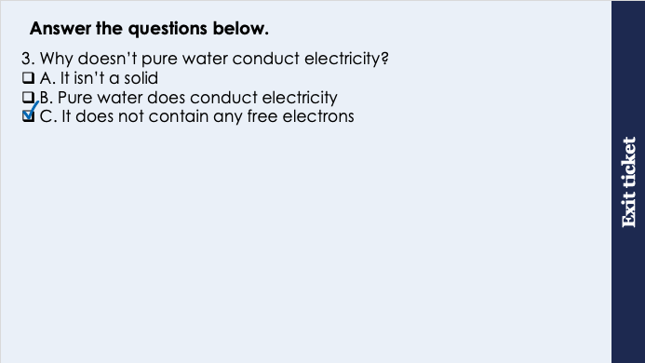
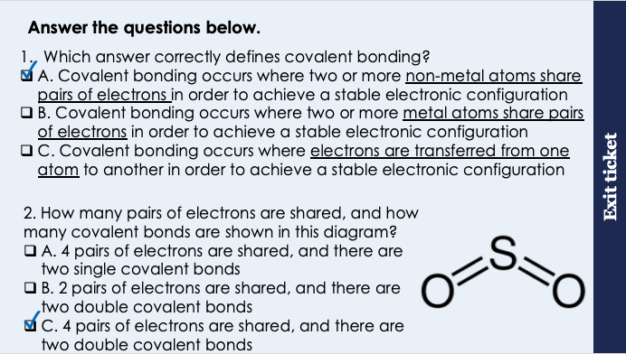
This is the fix-it portion of the lesson
The fix-it is an opportunity to respond to gaps in knowledge, especially those identified by the pre-unit quiz.
The teacher should customise this slide as needed, to facilitate
reteach, explanation, demonstration or modelling of ideas and concepts that students have not yet grasped or have misunderstood.
practise answering specific questions or of key skills.
redrafting or improving previous work.
Notes:
Purpose: to spend time on any gaps identified in previous learning from previous exit ticket.
Guidance from previous exit ticket:
Q1. Answer: A
If students answer B, they have mistakenly suggested that covalent bonding occurs between metal atoms instead of non-metal atoms. To fix-it, remind students that metallic and ionic bonding involve at least one metal atoms, but covalent is always involving only non-metals.
If students answer C, they have mixed up ionic bonding and covalent bonding. Model the process of each of these with dot-and-cross diagrams on the board to show the difference.
Q2. Answer: C
If students answer A, they do not recall that a double line represents a double covalent bond. If students answer B, they do not know that a double line represents 2 pairs of electrons, so two double lines represents 4 pairs of electrons in total in this molecule (1 line represents 1 pair of electrons). To fix-it, give students other examples of covalent compounds and ask them to deduce the number of electron pairs shared and the number of covalent bonds.
Q3. Answer: C
If students answer A, they think that in order to conduct electricity, a substance must be a solid. If students answer B, they have the misconception that pure water conducts electricity (and have disregarded the property taught in this lesson in favour of this misconception). To fix-it, demonstrate an ionic solution conducting electricity with a simple circuit and lamp. To fix-it, explain that because water is a simple covalent substance it does not conduct electricity, as there are no free electrons or ions to carry the charge. Explain that water can conduct electricity if we dissolve certain substances in it, such as salt, because then we have an ionic substance dissolved and the ions can move through the liquid and carry a charge.

Slide 8
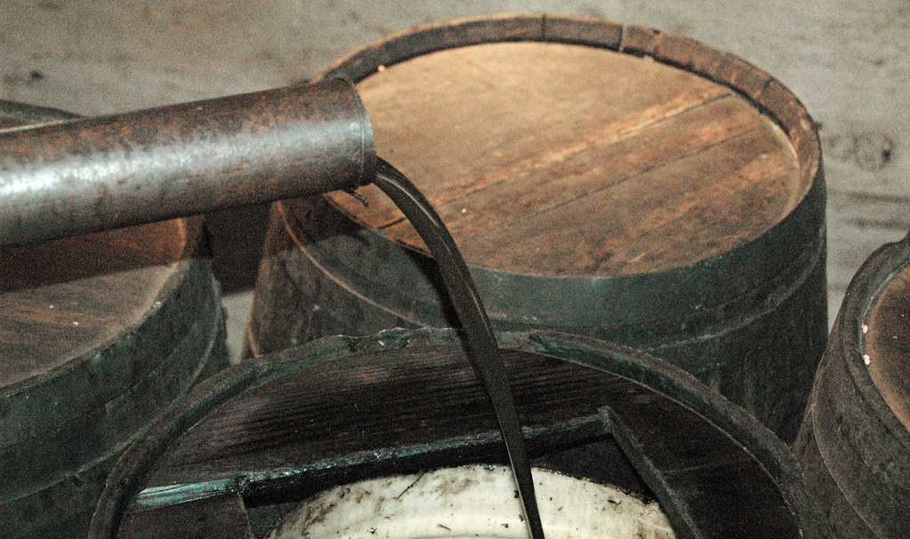
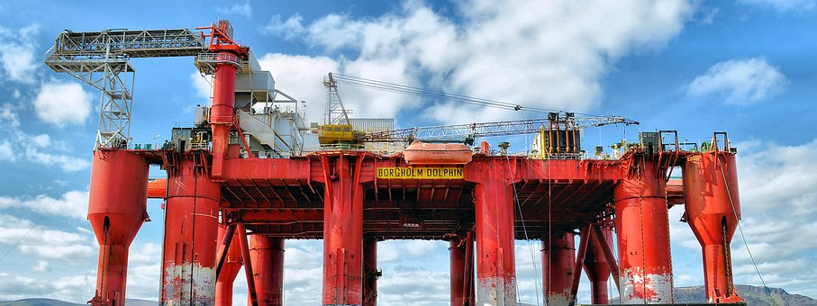
Crude Oil
Crude oil is an important resource used for fuel, heating and making plastics, solvents, lubricants and detergents.
It is a finite resource formed over millions of years from the remains of ancient biomass, mainly plankton, that was buried under mud and compressed.
Crude oil is a mixture of many different compounds.
Notes:
Suggested exposition:
Crude oil is one of the most useful resources on Earth and we use it in many everyday items without thinking about it! It is used for fuels, heating and making plastics, solvents, lubricants and detergents and many other uses, including tarmac for roads. It is also used as petrochemical feedstock, which means a raw material used as a reactant for chemical reactions.
Crude oil is a finite resource.
What does this mean?
It will eventually run out, it is being used up faster than it can be replenished.
This is because crude oil has been formed over millions of years. It has been formed from the remains of ancient biomass, mainly from plankton that was buried under mud then compressed under rocks for many millions of years.
What is biomass?
Matter from living or recently living organisms.
Crude oil is a very thick liquid, usually brown-black in colour, but it is actually a mixture. This is because it contains a large number of different compounds. It is obtained from drilling deep underground or under the sea.
Image source
https://www.flickr.com/photos/jsjgeology/50118147021
Oil rig from pixabay

Slide 9
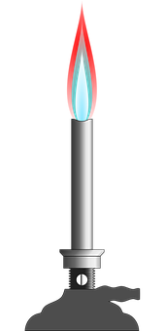
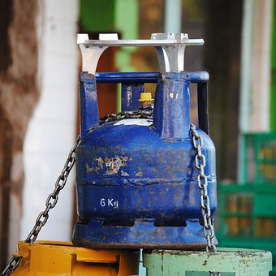
Hydrocarbons
Most of the compounds in crude oil are hydrocarbons.
Hydrocarbons are molecules made up of hydrogen and carbon atoms only.
Most of the hydrocarbons in crude oil are part of a homologous series called the alkanes.
The alkanes include:
Methane
Ethane
Propane
Butane
Notes:
Suggested exposition:
Crude oil is a mixture of many different compounds. Most of the compounds in crude oil are hydrocarbons, which are molecules made up of hydrogen and carbon atoms only.
The main type of hydrocarbons found in crude oil are part of a family of compounds called the alkanes. The alkanes their own homologous series. A homologous series is a group or ‘family’ of carbon compounds that all have the same functional group, which we will learn about later, and similar chemical properties.
The alkanes include methane, ethane, propane and butane.
What do they have in common?
Their names all end -ane, which shows that they are alkanes.
Methane is the gas used in Bunsen burners and propane and butane are also used as gases for fuels. As the alkanes get larger their boiling points increase, so larger alkanes are liquid at room temperature, but we will look at this in more detail in the next lesson.
Images from pixabay

Slide 10
The Alkanes
Methane
Monkeys
Ethane
Eat
H
H
H
H
H
H
C
C
H
C₂H₆
C
CH₄
H
H
H
Propane
Peanut
Butane
Butter
H
H
H
H
H
H
H
H
C
C
C
H
H
C
C
C
C
H
C₃H₈
C₄H₁₀
H
H
H
H
H
H
H
Notes:
Suggested exposition:
Let’s look at the alkanes in more detail.
Animate each of the alkanes.
These are the structural formulae of the alkanes.
What is the chemical formula of each?
Animate the chemical formula of each.
What do they have in common?
They all have carbons bonded to hydrogens.
We can remember the order of the first four alkanes using the acronym monkeys eat peanut butter.
The alkanes differ from each other by a CH2 group, as you can see as more carbons are added, then more hydrogens need to be added. The alkanes have a general formula, which is C_{n}H_{2n+2}.
So however many carbon atoms there are, there are 2 times this number + 2 hydrogen atoms. We’ll practice this in the I/We/You cycle.

Slide 11
Bonding in the Alkanes
Methane
Ethane
X
X
X
X
X
X
X
X
X
X
X
The alkanes are described as saturated because they contain only single bonds, no double bonds.
Notes:
Suggested exposition:
We should remember from C4.1 that methane is a small covalent molecule, where the hydrogen and carbon atoms bond by sharing pairs of electrons so that each atom has a full outer shell.
Usually we just show the outer electrons in dot and cross diagrams.
So we know that methane is a covalently bonded molecule, the rest of the alkanes are the same.
Animate ethane.
This is ethane - the carbon atoms are also bonded to each other as well as the hydrogens.
The alkanes are described as saturated. This is because they contain only single bonds between the carbon atoms. We will go on to look at other homologous groups that are described as unsaturated because they contain double bonds.

Slide 12
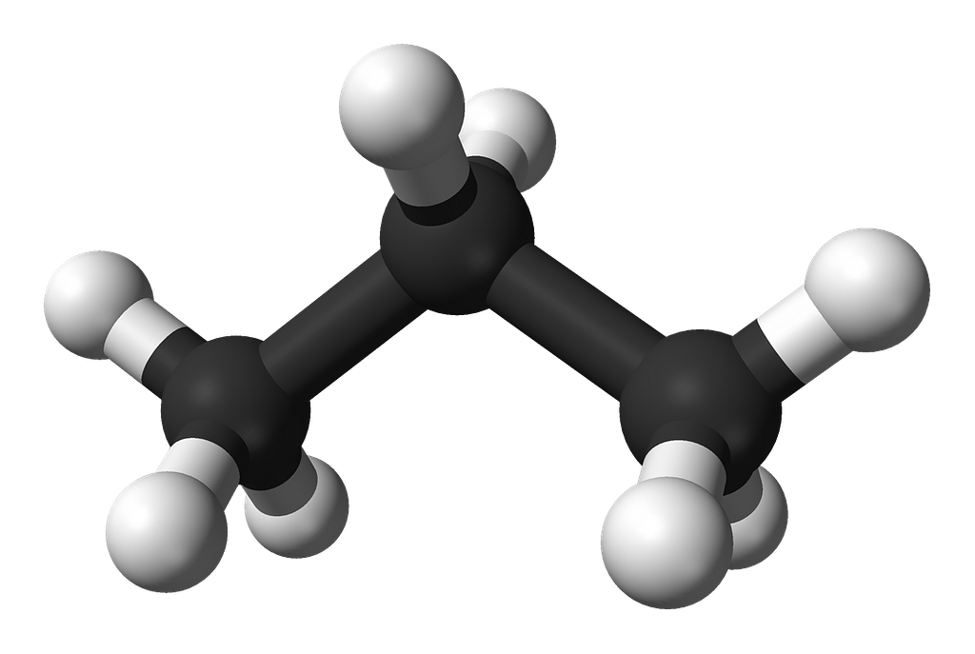
Using Models
H
H
H
H
C
C
C
H
H
H
H
C₃H₈
Propane
Notes:
Suggested exposition:
We can draw the structural formula of the alkanes to show how many bonds each atom has made. This provides us a good 2D model of each alkane molecule. However, these structural formula do not show the actual shapes of the molecules.
Animate 3D model. This is also a useful opportunity to show students/get students to make the molymods of the first four alkanes.
This is called a ball and stick model, which gives us a 3D view of the propane molecule. The black spheres represent carbon atoms and the white spheres represent hydrogen atoms.
What do the ’sticks’ represent?
Covalent bonds
The advantage of this ball and stick model is that we can see the shape of the molecule in 3D, and see that the bonds are not actually at 90º to each other.
(note - students are not expected to know bond angles or molecule shapes until A-Level)
We can use either model to determine the chemical formula (and therefore the name) of the molecule.
What is the chemical formula of this molecule?
C₃H₈
What is this alkane?
Propane

Slide 13




Which statements do you agree with?
The general formula for alkanes is C_{n}H_{2n}
The general formula for alkanes is C_{n}H_{2(n+2)}
The general formula for alkanes is C_{n}H_{2n+2}
The general formula for alkanes is C_{n}H_{n+2}
Notes:
Suggested points:
This talk task is designed to ensure that students are confident with the general formula of the alkanes. Green is the correct answer, the others are all answers that many students have given in exam questions.
Suggested guidance:
Talk tasks can be used in a variety of ways to suit the particular needs of the students you are teaching. Through exchanging views with others, students develop their understanding of the science beyond what could be achieved individually.
Science classrooms that successfully integrate talk have the following features:
Science talk is a regular feature of lessons and is woven into classroom activities.
Students are paired or grouped strategically by the teacher to ensure productive interaction. This might take into consideration the students’ proficiency of the English language, how encouraging they might be to peers and their attainment in the topic. It’s a good idea to consider these pairings in the class seating plan.
Students are encouraged and supported to talk, but are not forced to talk.
The teacher should take on the role of a facilitator, engaging with conversations where necessary and encouraging or steering the conversation where needed.
Students are encouraged to use the language they have to express their ideas (e.g., everyday language, imperfect English, native language), but also to incorporate science specific terminology where this is more accurate or has been taught.
6. Scientifically inaccurate ideas are not dismissed by the partner or teacher; open discussion and further investigation are relied on to help students construct ideas that support them to progress in their scientific understanding.
7. Guidelines for behaviour during talk tasks are explicit and frequently reviewed. Rules for students might be:
Listen carefully to your partner
Take turns talking.
Speak one at a time, without interrupting.
Politely agree or disagree and explain why.
Politely point out if your partner has used a scientific word incorrectly, if they have explained the science incorrectly, or if there is a more accurate way to describe something.
If confused, ask questions.
Stay focused on the discussion topic.
Respond to one another.

Slide 14
What mistakes has the student made?
A student has drawn the displayed formulae for two alkanes, propane and butane.
They have made a mistake on each.
What are the two mistakes?
H
H
Propane
H
C
C
H
H
H
They have drawn ethane instead of propane
Butane is missing the hydrogen atoms on either end of the molecule
Butane
H
H
H
H
C
C
C
C
H
H
H
H

Slide 15
Drill
Describe where crude oil is found.
Describe what crude oil is made from.
Explain why crude oil is a mixture.
Define a hydrocarbon.
State the general formula of the alkanes.
Name the alkane with 1 carbon.
Name the alkane with 4 carbons.
Draw the displayed formula for the alkane with 3 carbons.
Notes:
Purpose: This is a knowledge drill. The purpose of this is to check that the critical knowledge is secure before pupils move onto independent practice.
Suggested guidance: There are a range of ways this could be done depending on time and ability range of the class:
Mini whiteboards
As full sentences in exercise books
As short answers in exercise books
In the pupil workbook
As pair talk
As cold call

Slide 16
Drill answers
Deep underground under rocks
Ancient biomass (mainly plankton) that was buried in mud.
It contains different compounds.
Molecules made of carbon and hydrogen atoms only.
C_{n}H_{2n+2}
Methane
Butane
8.
H
H
H
H
C
C
C
H
H
H
H
Notes:
Purpose: This is a knowledge drill. The purpose of this is to check that the critical knowledge is secure before pupils move onto independent practice.
Suggested guidance: There are a range of ways this could be done depending on time and ability range of the class:
Mini whiteboards
As full sentences in exercise books
As short answers in exercise books
In the pupil workbook
As pair talk
As cold call

Slide 17
I: Alkane Formulae
We can use the general formula of alkanes to determine how many atoms are in a given molecule.
What is the general formula of the alkanes?
C_{n}H_{2n+2}
How many hydrogen atoms would there be in an alkane with 5 carbons?
C_{n}H_{2n+2}
n=5
2n + 2 = (2x5) + 2 = 12
C₅H₁₂
How many carbon atoms would there be in an alkane with 14 hydrogens?
C_{n}H_{2n+2}
2n + 2 = 14
2n = 12
n = 6
C₆H₁₄
Notes:
Purpose: The I-We-You section aims to support pupils to build skills that they most commonly need when answering questions associated with this knowledge in the assessment. This section is also used to interleave other content we expect pupils to know at this stage of their education in order that they build a big picture of the science they are learning.
For the ‘I’ activity, the teacher should model how to answer the question. They can do this by narrating their thinking process aloud, and making links to learning earlier in the lesson explicit.
For the ‘we’ activity, the teacher and students work though a similar example together, in order to prepare students to be able to answer a similar question independently.
Opportunities for the ‘you’ activity – independent practise – occur in the activity portion of the lesson once the student is secure enough to process independently.

Slide 18
We: Alkane Formulae
We can use the general formula of alkanes to determine how many atoms are in a given molecule.
What is the general formula of the alkanes?
C_{n}H_{2n+2}
How many hydrogen atoms would there be in an alkane with 8 carbons?
C_{n}H_{2n+2}
n=8
2n + 2 = (2x8) + 2 = 18
C₈H₁₈
How many carbon atoms would there be in an alkane with 22 hydrogens?
C_{n}H_{2n+2}
2n + 2 = 22
2n = 20
n = 10
C₁₀H₂₂
Notes:
Purpose: The I-We-You section aims to support pupils to build skills that they most commonly need when answering questions associated with this knowledge in the assessment. This section is also used to interleave other content we expect pupils to know at this stage of their education in order that they build a big picture of the science they are learning.
For the ‘I’ activity, the teacher should model how to answer the question. They can do this by narrating their thinking process aloud, and making links to learning earlier in the lesson explicit.
For the ‘we’ activity, the teacher and students work though a similar example together, in order to prepare students to be able to answer a similar question independently.
Opportunities for the ‘you’ activity – independent practise – occur in the activity portion of the lesson once the student is secure enough to process independently.

Slide 19
You: Alkane Formulae
We can use the general formula of alkanes to determine how many atoms are in a given molecule.
What is the general formula of the alkanes?
C_{n}H_{2n+2}
How many hydrogen atoms would there be in an alkane with 12 carbons?
C_{n}H_{2n+2}
n=12
2n + 2 = (2x12) + 2 = 26
C₁₂H₂₆
How many carbon atoms would there be in an alkane with 38 hydrogens?
C_{n}H_{2n+2}
2n + 2 = 38
2n = 36
n = 18
C₁₈H₃₈
Notes:
Purpose: The I-We-You section aims to support pupils to build skills that they most commonly need when answering questions associated with this knowledge in the assessment. This section is also used to interleave other content we expect pupils to know at this stage of their education in order that they build a big picture of the science they are learning.
For the ‘I’ activity, the teacher should model how to answer the question. They can do this by narrating their thinking process aloud, and making links to learning earlier in the lesson explicit.
For the ‘we’ activity, the teacher and students work though a similar example together, in order to prepare students to be able to answer a similar question independently.
Opportunities for the ‘you’ activity – independent practise – occur in the activity portion of the lesson once the student is secure enough to process independently.

Slide 20
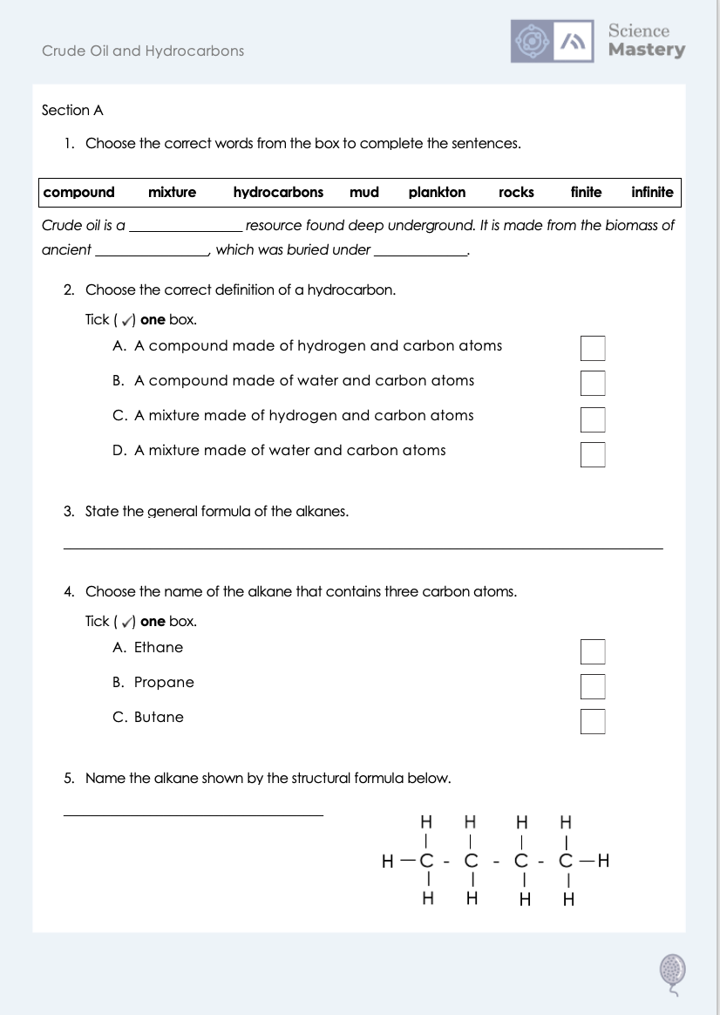
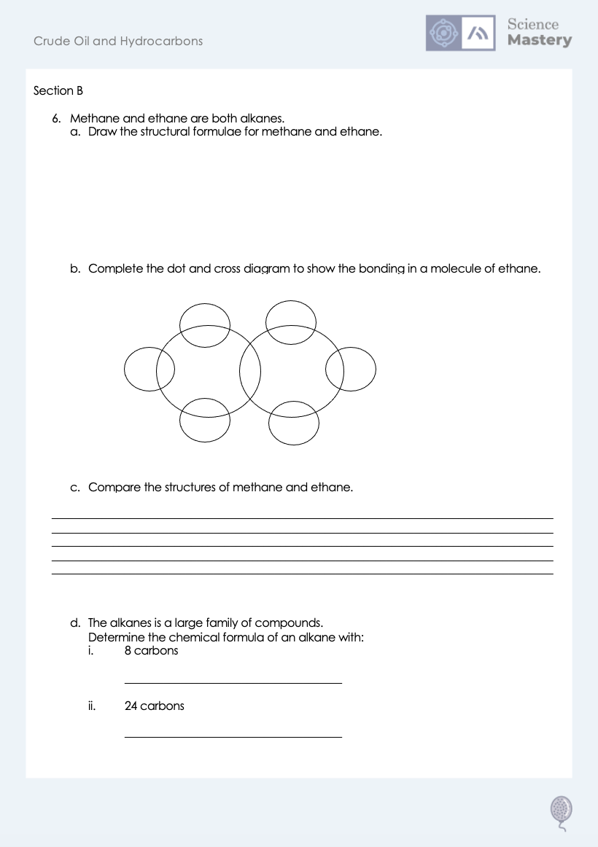
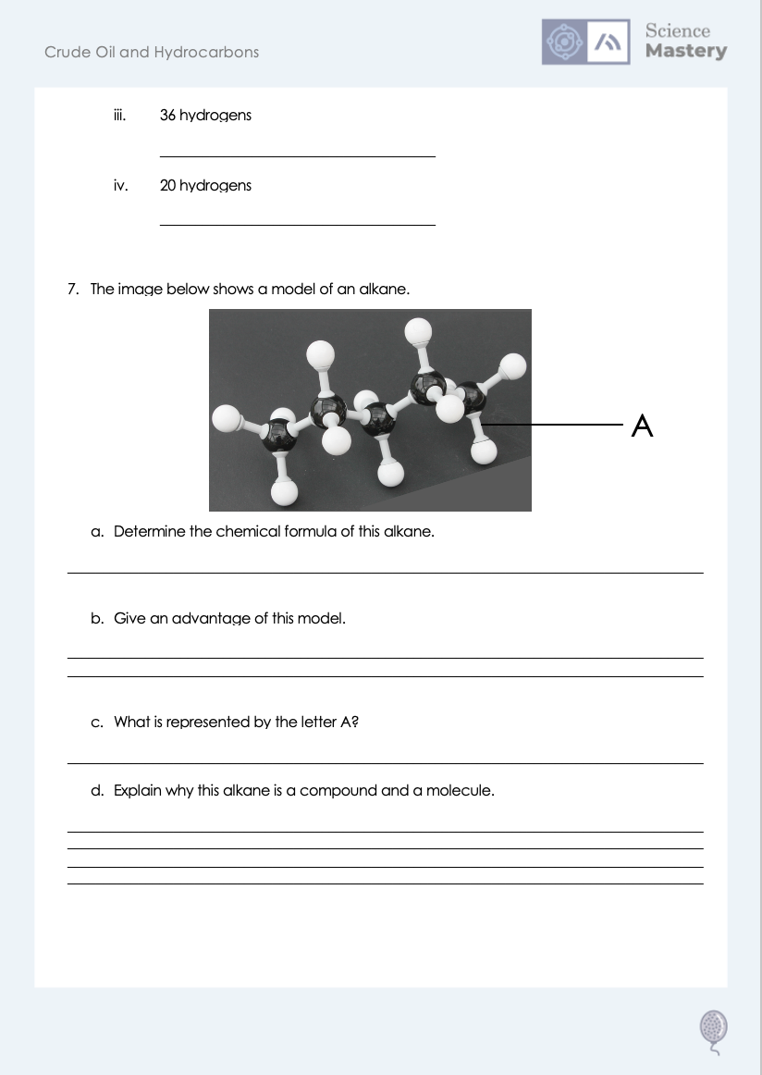
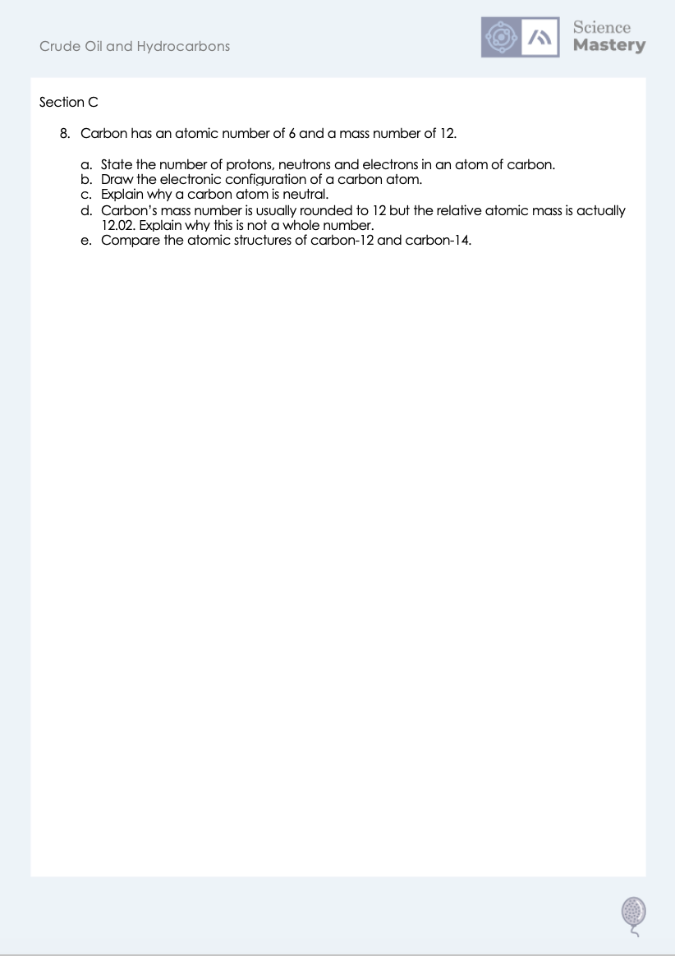
Worksheet

Slide 21
Answers
1. Crude oil is a finite resource found deep underground. It is made from the biomass of ancient plankton, which was buried under mud.
2. A - A compound made of hydrogen and carbon atoms
3. C_{n}H_{2n+2}
4. B - propane
5. butane

Slide 22
Answers
6a. Methane Ethane
H
H
H
H
C
H
H
C
C
H
H
H
H
6b.
X
X
X
X
X
X
X

Slide 23
Answers
6c.
Both are alkanes
Both are hydrocarbons/contain only carbon and hydrogen atoms
Both contain covalent bonds
Methane has 1 carbon atom, ethane has 2 carbon atoms
Methane has 4 carbon atoms, ethane has 6 carbon atoms
Ethane also contains a carbon-carbon bond, but methane only has carbon-hydrogen bonds
6di. C₈H₁₈
6dii. C₂₄H₅₀
6diii. C₁₇H₃₆
6div. C₉H₂₀

Slide 24
Answers
7a. C₅H₁₂
7b. It shows the shape of the molecule in 3D. The bonds are not really at 90º to each other.
7c. A covalent bond
7d. It contains two different types of atom (elements) chemically bonded together and the atoms are non-metals covalently bonded together.

Slide 25
Answers
8a. 6 protons, 6 neutrons, 6 electrons
8b.
X
X
X
X
X
X
8c. It contains the same number of (positively charged) protons and (negatively charged) electrons.
8d. It has isotopes with different atomic mass numbers.
8e. Both types of carbon atom contain 6 protons but carbon-12 contains 6 neutrons and carbon-14 contains 8 neutrons.

Slide 26
Answer the questions below.
H
H
H
Which alkane is this?
A. Ethane
B. Propane
C. Butane
H
C
C
C
H
✓
H
H
H
An alkane has 15 carbons. How many hydrogen atoms would it have?
A. 30
B. 32
C. 34
✓
What is crude oil?
A. A finite resource formed from ancient plankton biomass
B. A finite resource formed from rocks
C. A finite resource containing compounds of carbon and water
✓
Notes:
Q1. Answer: B
If students answer A or C, they have not grasped the names of the first four alkanes. To fix it, review the names and formulae of the first four alkanes using the acronym Monkeys Eat Peanut Butter.
Q2. Answer: B
If students answer A, they have doubled but not added two, which is a common error. If students answer C they have added two before doubling. To fix it, give students more practice working out numbers of carbons and hydrogen atoms in different alkanes.
Q3. Answer: A
If students answer B, they have the misconception that crude oil is formed from the rocks themselves rather than found underground under rocks. If students answer C, they have the misconception that ‘hydro’ in hydrocarbons means water rather than hydrogen. To fix it, review what crude oil is made from and where it is found.

Slide 27
Lesson C5.1.2
What was good about this lesson? | What can we do to improve this lesson?
Send us your feedback by clicking this link
or by emailing sciencemastery@arkonline.org
Thank you!

